Slide 1




Campus for Hope Overview
Kim Jefferies, CEO

Slide 2
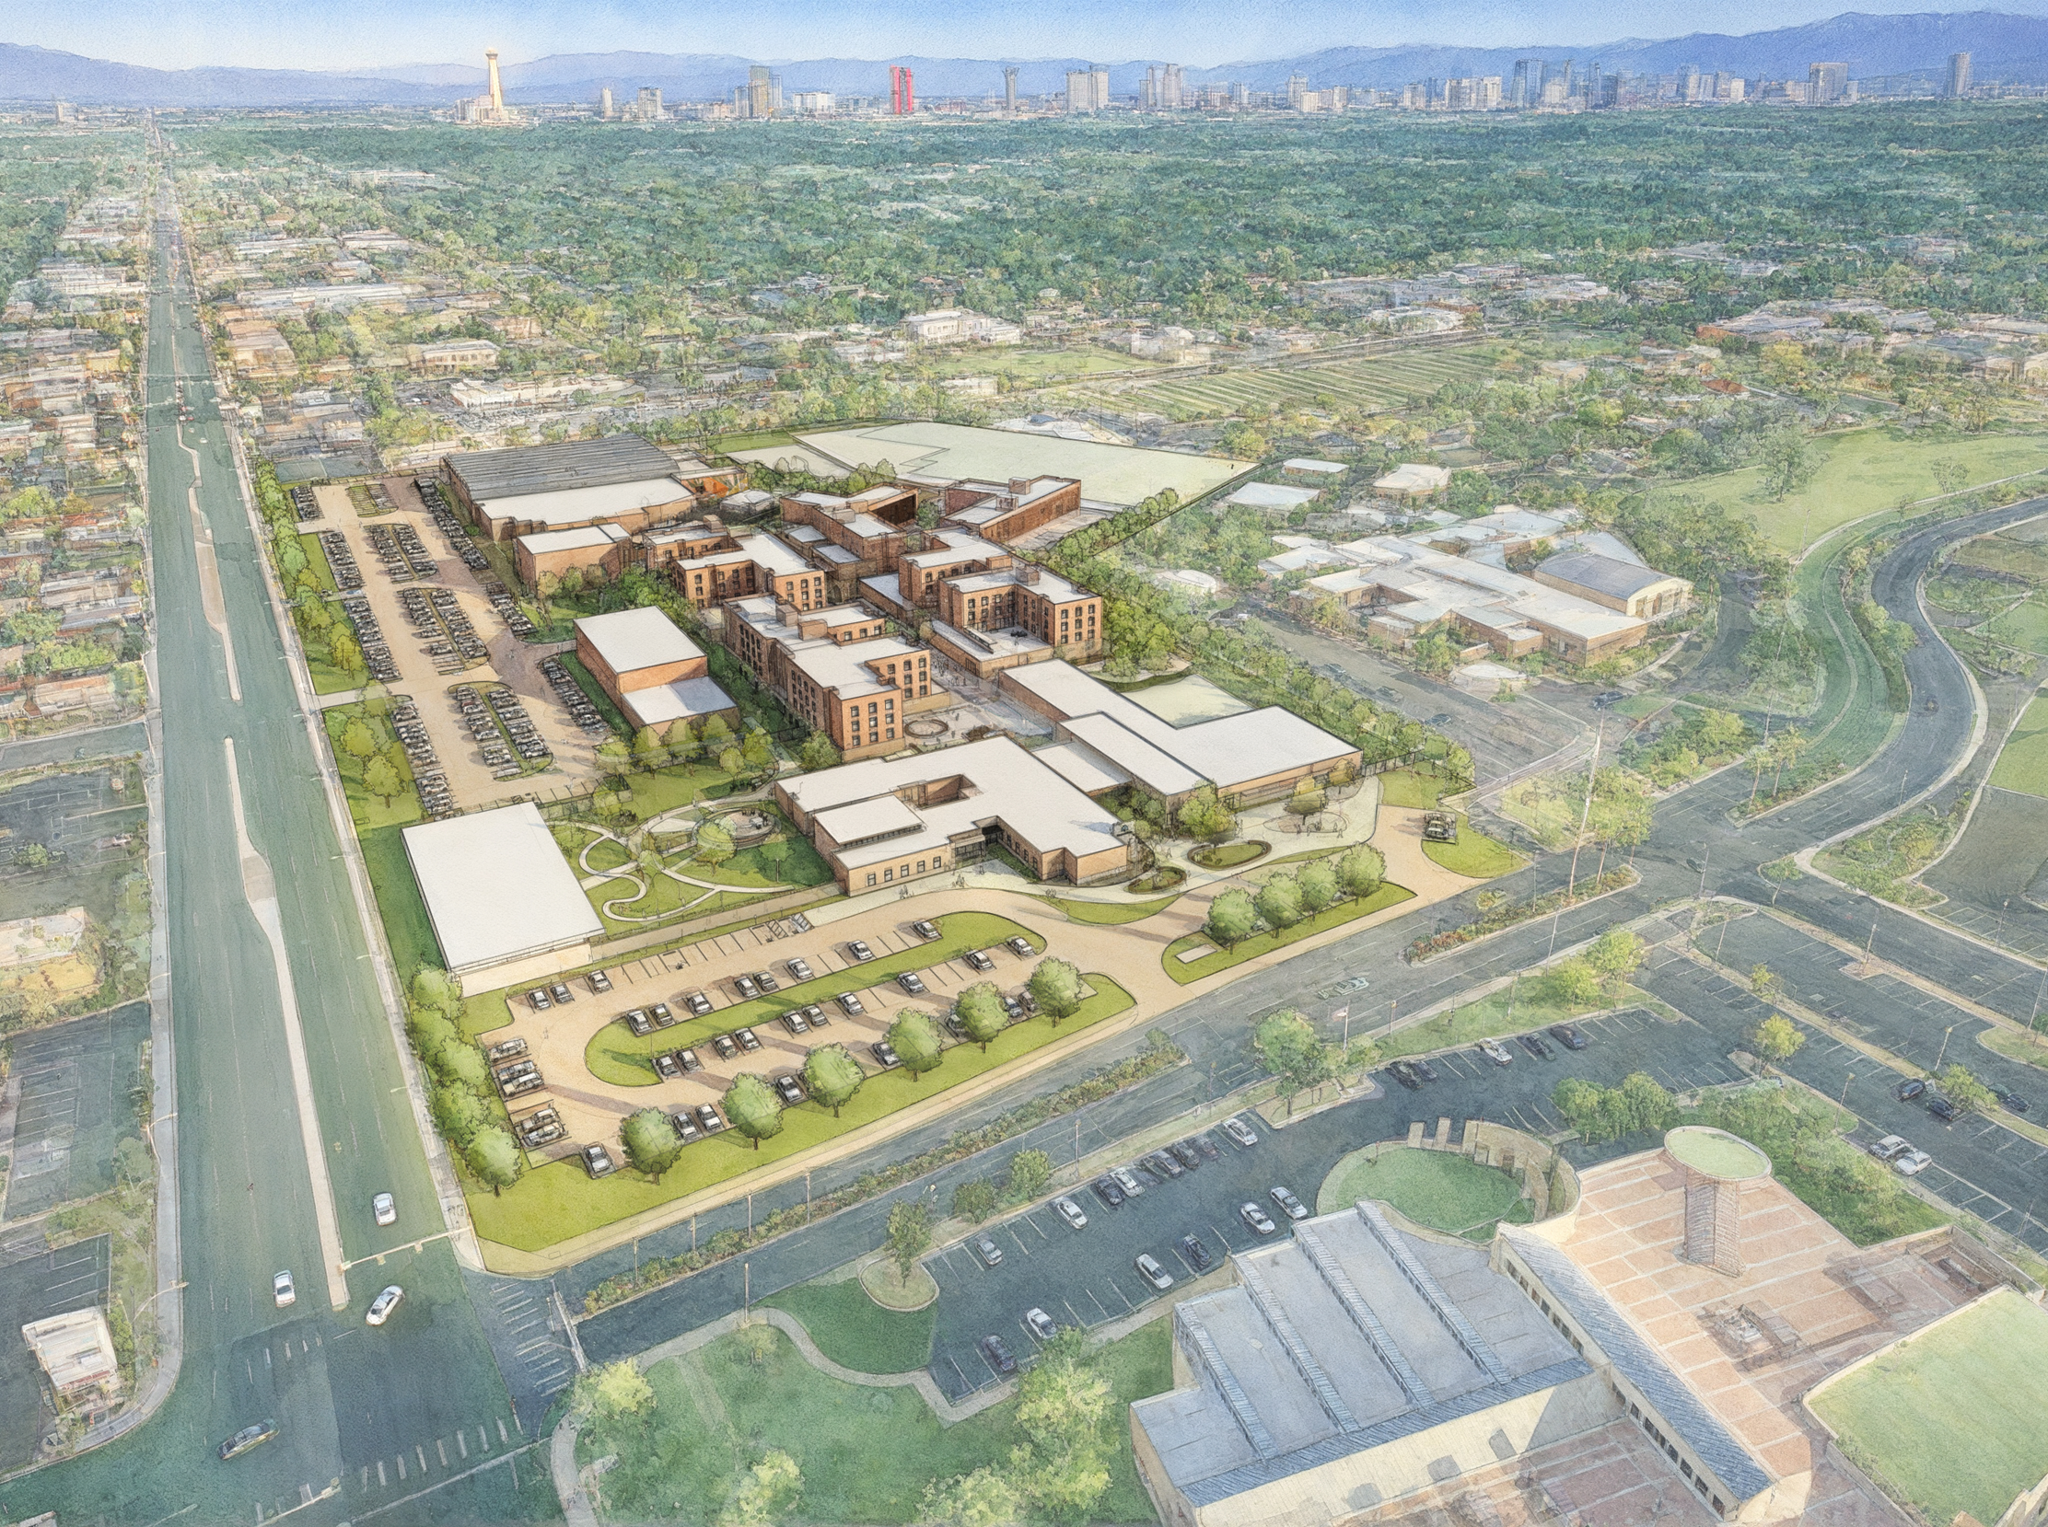

Campus for Hope is a transformative investment
±25
Acres
±900
Occupancy

Slide 3

The campus will provide comprehensive wrap around services in a trauma-informed environment with the ultimate goal of ending a person’s homelessness

Slide 4





Mission, Vision & Values
Our Mission: Revolutionize support for the unhoused by creating comprehensive and compassionate pathways to achievement.
Our Belief: Each life brings a unique gift to the world, without it, the world is diminished.
Our Pledge: We pledge to stand with every person, helping them reclaim home, hope, and the chance to the thrive.
Our Core Values: Honor, Connect, Uplift, Integrate

Slide 5
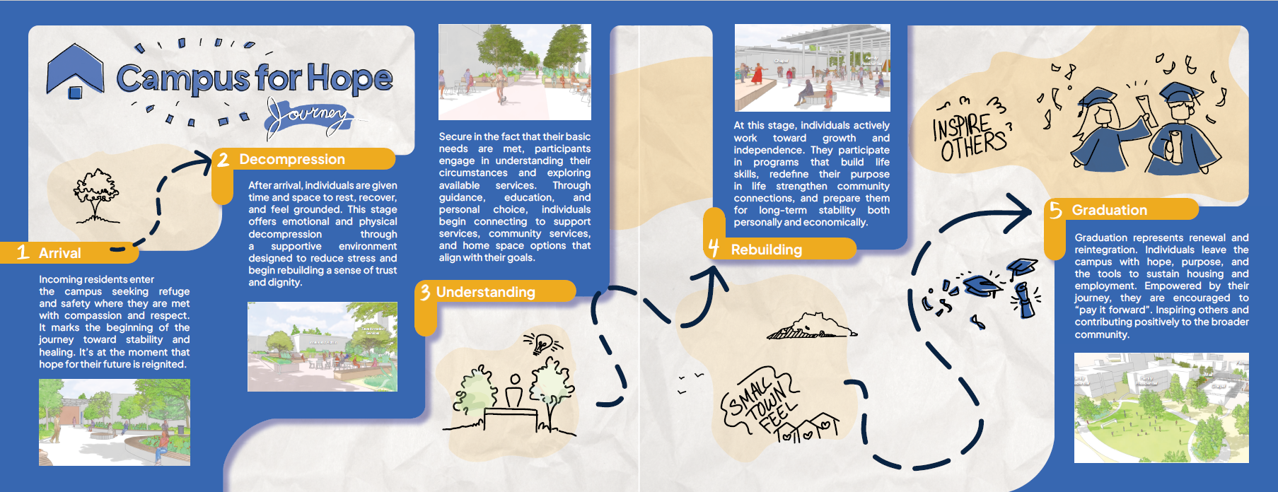
Campus for Hope Journey

Slide 6

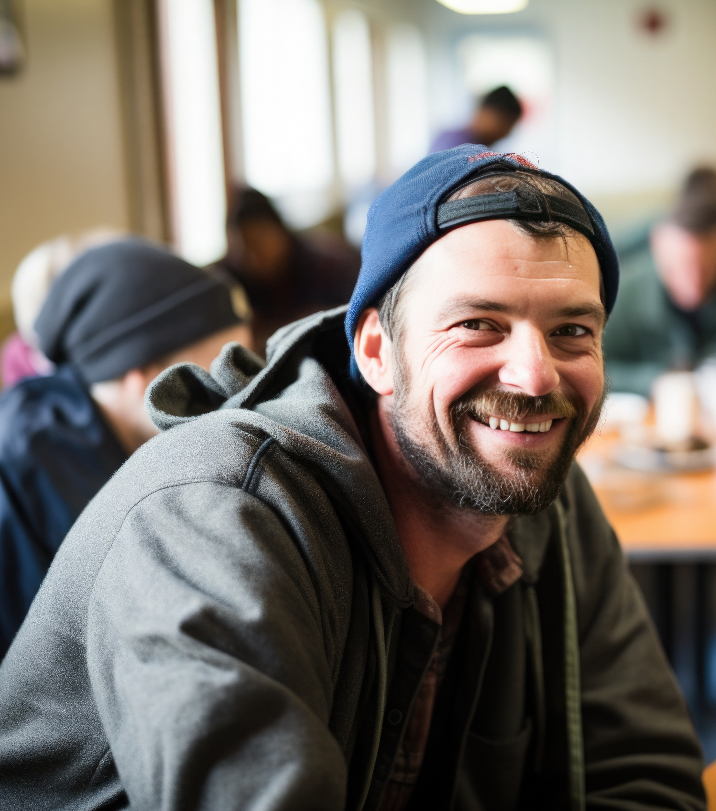


Campus for Hope Client Profiles
Economically Displaced Individuals and Families
Singles with Low to Moderate Acuity
Individuals Exiting or Experience with Adjacent Systems
Individuals and Families Fleeing Domestic Violence
Individuals and families who are unable to sustain their housing due to economic reasons (loss of job, loss of loved one, medical event, cost burdened, significant financial event, etc.).
Individuals who are unable to sustain their housing due to behavioral health or substance use needs who have the ability to be stabilized and make progress towards recovery.
Individuals who are unable to sustain their housing due to exiting current temporary housing such as through eviction courts, military/veterans, recent involvement with the justice system (with eligible backgrounds) or healthcare.
Individuals and families who are unable to sustain their housing due to fleeing a current situation of domestic violence. DV providers remain the preferred placement, but Campus for Hope will serve as overflow.
We understand that individuals and families are not impacted by only one profile and will ensure support is comprehensive across profiles.

Slide 7







What Sets Campus for Hope Apart
DIFFERENTIATORS
Support built around each person, day and night
EMBEDDED CASE MANAGEMENT
24/7 RESIDENT & SECURITY STAFF
PERSON-CENTERED, TRAUMA-INFORMED CARE
Case managers work inside the residential buildings, alongside clients, instead of by appointment only. This allows the case manager to get to know the client in all settings and the client immediate access to support.
Resident staff and security on site around the clock, so clients have support whenever they need it. CFH will hire and train their operational teams to support trauma informed care, de-escalation and in crisis management.
Case management built around each person's goals and history, delivered with a trauma-informed approach. CFH will have a dedicated resident experience team to ensure CFH is responsive to client needs and is creating an environment for transformation.
TRAUMA-INFORMED CAMPUS DESIGN
FAMILIES, COUPLES & PETS WELCOME
A PATH TO HOUSING
Rooms for everyone with no open pods, and smaller "safe pods" for safety and flexibility. Spaces across the campus that provide choice and safety – calm rooms, libraries, social rooms, healing garden, community garden, outdoor and indoor spaces.
Couples' dorm, young adult dorm, LGBTQ+ dorm, family dorm, singles rooms and a cattery and 40 indoor dog kennels from opening day. CFH welcomes everyone!
A dedicated housing navigation team, plus first month's rent, deposit and a move-out kit. CFH separates out Housing Navigation from case management and has an entire team dedicated to supporting housing.
© All Rights Reserved Campus for Hope Foundation

Slide 8
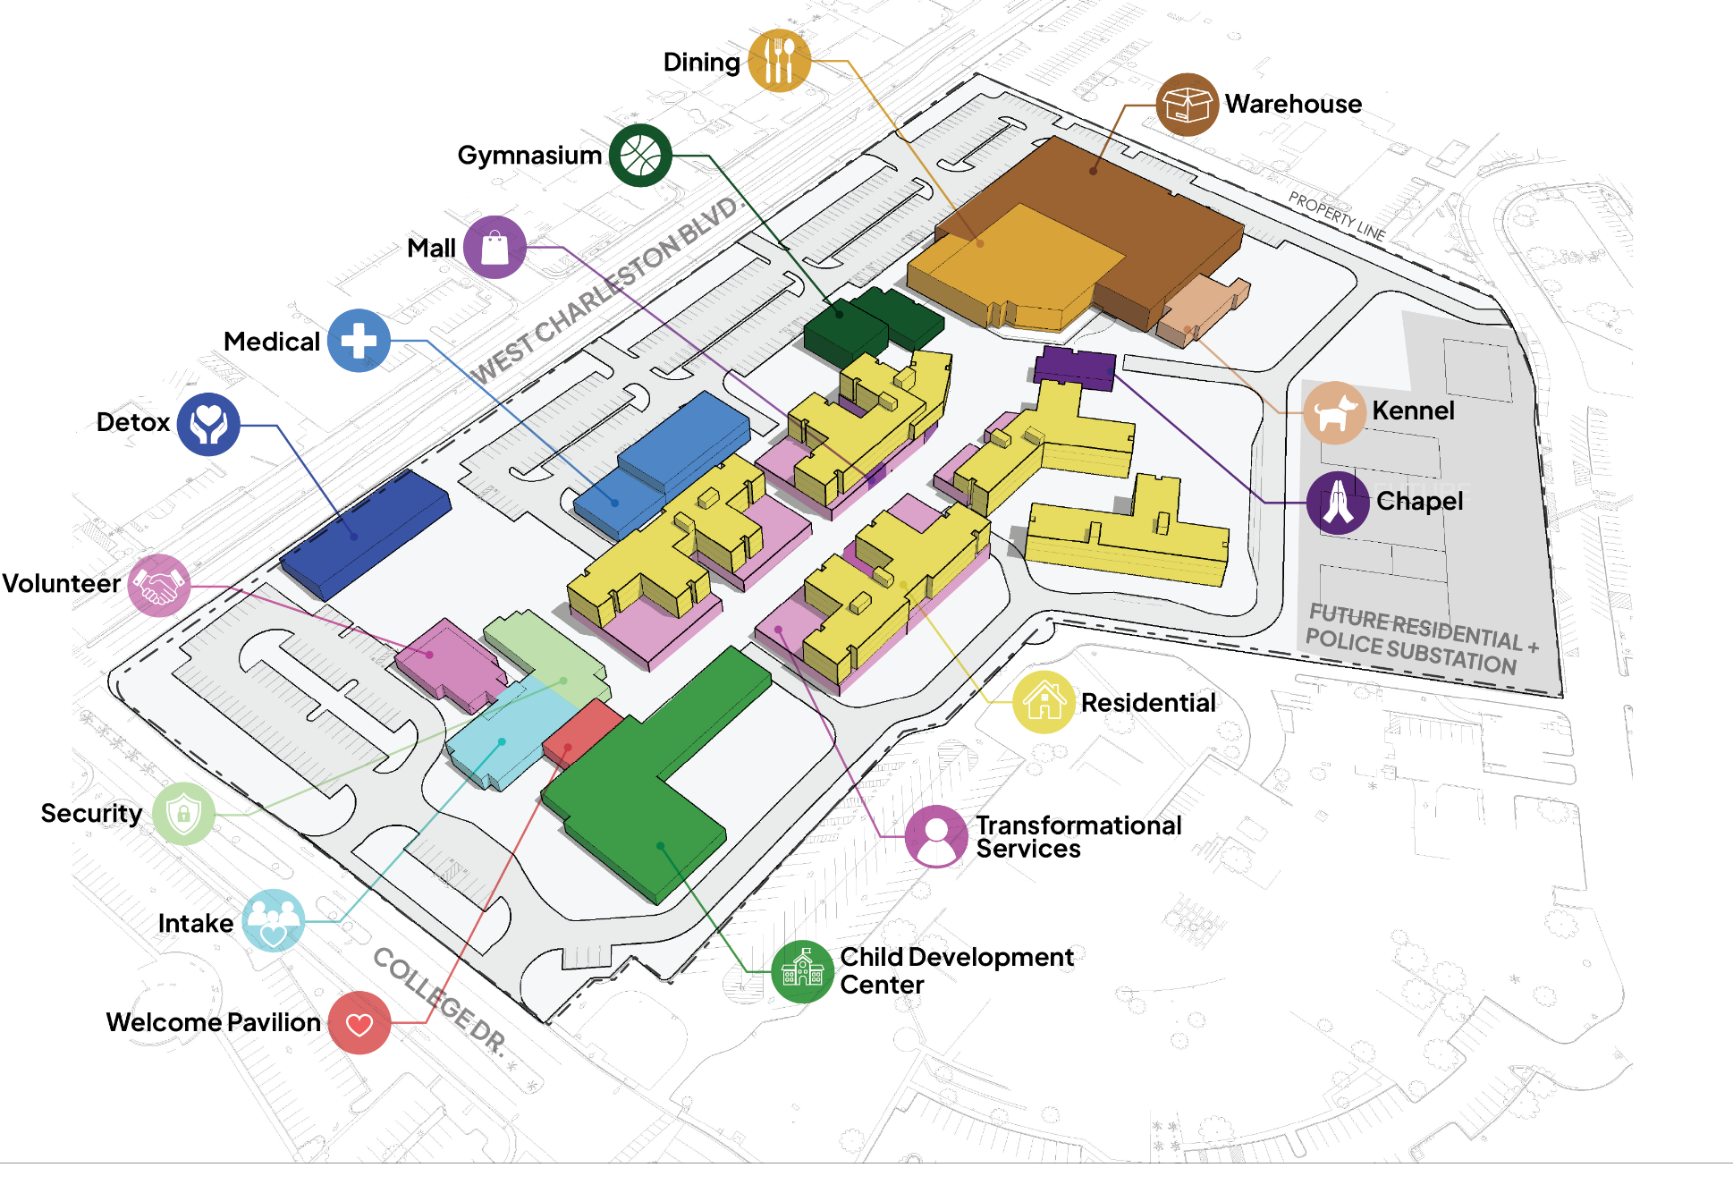
Campus Site plan
COMMONS
PROMENADE
ENTRY & CHILDCARE
ENTRY
Notes:
Main entry @ College Dr.
Arrival -
Struggling with crisis - Defer to detox
All other
Intake for client
In need
Childcare - Access to public

Slide 9
Wrap Around Services & Partners
Case Management
Housing Assistance
Health Care
Mental Health
Job Support
One-on-one
Guidance
Provided by Campus for Hope
Assistance finding and maintaining stable housing
Provided by Campus for Hope
Medical, dental
and vision support
Provided by Partner Agencies
Counseling, therapy
and behavioral
health care
Provided by Partner Agencies
Training, job placement and
career development
Provided by Partner Agencies
Basic Needs
Education Support
Legal Support
Family Services
And More!
Clothing, hygiene supplies and transportation
Provided by Campus for Hope
Help with GED, high school equivalency
classes and more
Provided by Partner Agencies
Access to legal
aid and advocacy
Provided by Partner Agencies
Childcare and support for parents and families
Provided by Partner Agencies
Additional resources to meet
individual needs

Slide 10








































Partner Agencies

Slide 11
Campus Master Plan
COMMONS
PROMENADE
ENTRY & CHILDCARE
Valued Added Services Available to Community:
Medical/Primary Care
Vision
Behavioral Health
Child Development Center
Social Enterprise
Gym (for events)
Volunteer Opportunities
ENTRY
Notes:
Main entry @ College Dr.
Arrival -
Struggling with crisis - Defer to detox
All other
Intake for client
In need
Childcare - Access to public

Slide 12
Residing on Campus & 24/7 Support
* Bed percentages may change slightly prior to opening
  Dorm Style (double occupancy)​ with shared restrooms
  Families have single occupancy rooms​
  Designed for maximum flexibility using safe pods of 16-18 beds (8 – 10 rooms)
  Average length of stay: 9 months​
  24/7 Operations and support for each client on campus

Slide 13
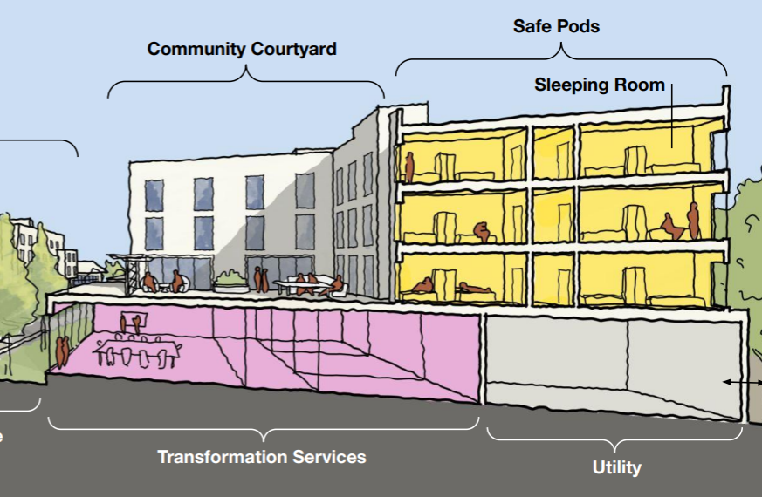
Special Features on Campus
Integrated into the Residential Buildings
  Embedded Case Manager Offices
  Study Rooms
  Recreation Room
  TV/ Lounge Areas
  Quiet Rooms
  Kids Playroom
  Teen Room
  Young Adults Learning Kitchen
  Family Private Dining Room
Mall Area
  Beauty Salon
  Barber Shop
  Bike Shop
  Clothing, Bedding & Toy Store
  Snack Bar
Gym with Fitness Center and Studio
Post Office
Dining Hall
  Microenterprise –Café
  2 Private Dining Rooms for Population Separation
Animal Care Center
  Kennels (38)
  Cattery
  Exotic Pet Area
Outdoor Spaces
  Healing Garden
  Community Garden
  Welcome Pavillion
  Promenade
  Commons Area
  Pet Walking Path
  Open park area

Slide 14
Welcome Center (Main Entrance)
MAINTAINING DESIGN QUALITY THROUGH VALUE ENGINEERING

Slide 15
Health and Healing Center

Slide 16
Residential Promenade
MAINTAINING DESIGN QUALITY THROUGH VALUE ENGINEERING

Slide 17
Social Enterprise, Gym & Secondary Entry (from Charleston)
CHARLESTON FACING CAMPUS

Slide 18
Road to buildout:
Implementation timeline
September 2025
Summer 2026 – Early 2028
Prepare the site for construction by clearing existing vegetation, debris, and demolishing structures that are not part of the redevelopment plan
Vertical construction of Campus for Hope;
staff recruitment and
team buildout
Summer
2025
January - May 2026
Summer
2028
Groundbreaking & preconstruction
Including all required
site planning and
development
Request for Partnership for services on the campus – consists of site visits, RFP submittals, RFP meetings and selection
Campus for
Hope Opens

Slide 19
Campus for Hope – Las Vegas
Notes:
Background music is playing throughout this slide.

